Slide 1
A Toxic Comment Identifier Application
Final Report
DSC 478 - Winter 2023
Project Type: App Dev
Team Members: Jeff Bocek, Xuyang Ji, Anna-Lisa Vu

Slide 2
We create a Python application that identifies whether a comment is toxic
Exploratory Analysis
Data Preprocessing
Model Tuning
Model Evaluation
App Development
Dataset from Kaggle competition:
https://www.kaggle.com/competitions/jigsaw-toxic-comment-classification-challenge/data?select=test.csv.zip

Slide 3
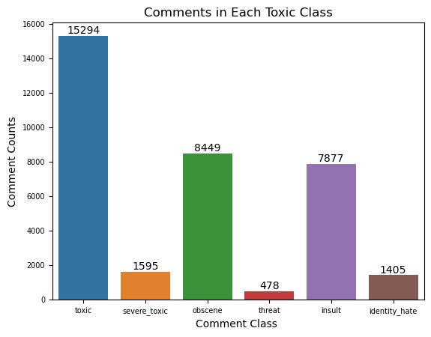
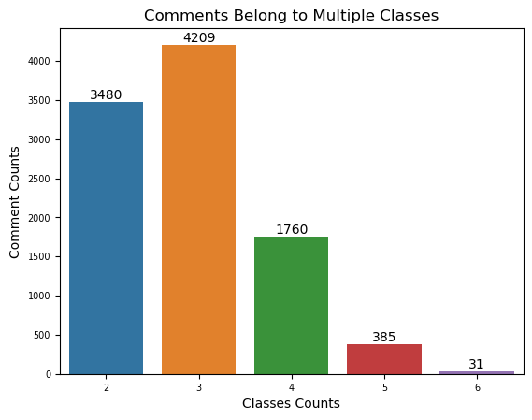
Exploratory

Slide 4
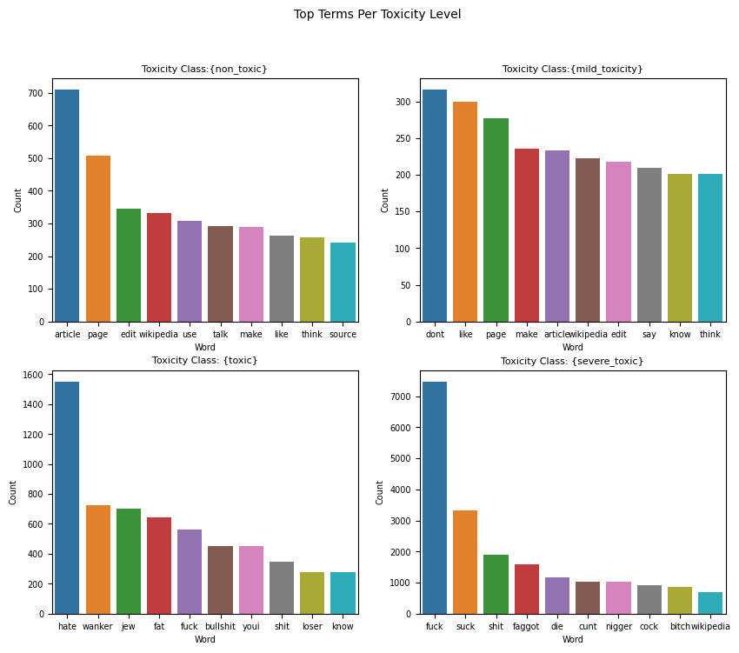
In Training Set

Slide 5
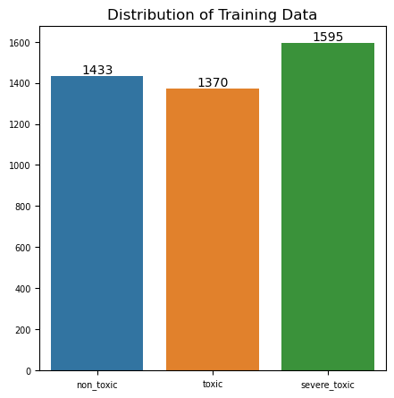
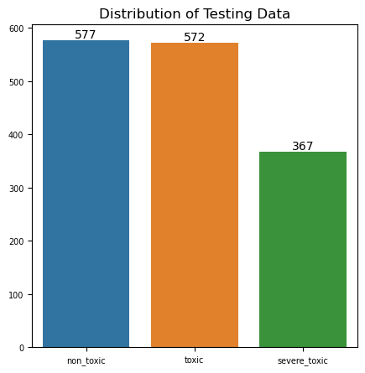
Data Preprocessing
Class resampling
Comment (test) cleaning via multiple steps (stemming, stop word removal, etc.)

Slide 6
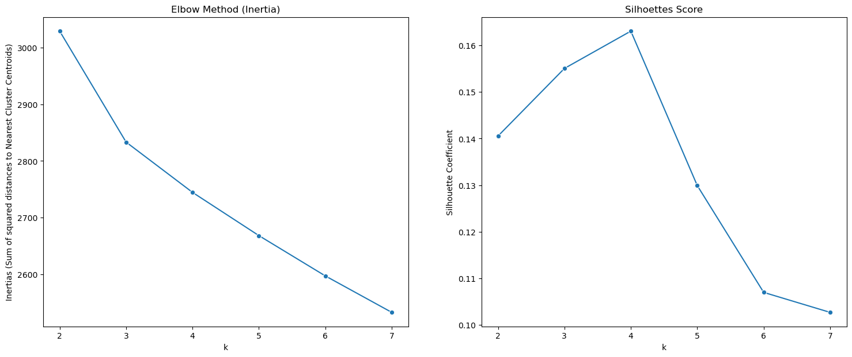
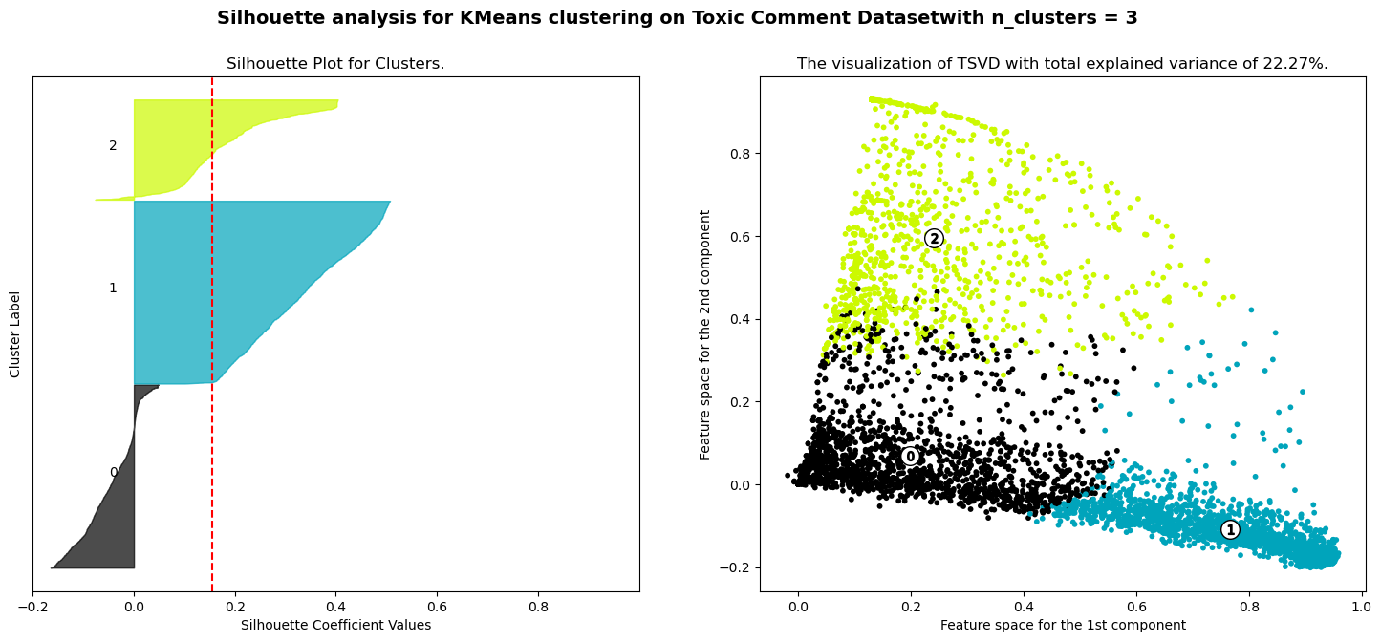
Exploratory – Cluster Analysis
K-Means

Slide 7
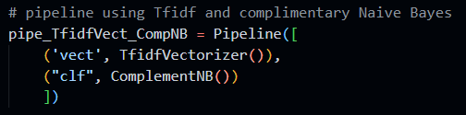
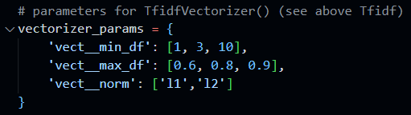
Model Tuning
Feature Reduction (Latent Semantic Analysis(LSA)
Used pipelines for Cross Validation Grid Searches
Feature Transformation
Term Frequency
TF*IDF
Doc2Vec
Classifiers
Gradient Descent/Logistic Regression
Nearest Centroid (Rocchio)
Naïve Bayes
KNN

Slide 8
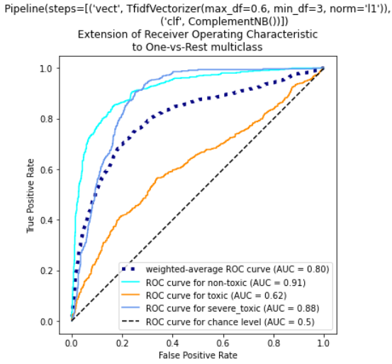
Model Evaluation
Train vs Test Accuracies
ROC_AUC when able
Confusion matrices
Precision
Recall
F1

Slide 9
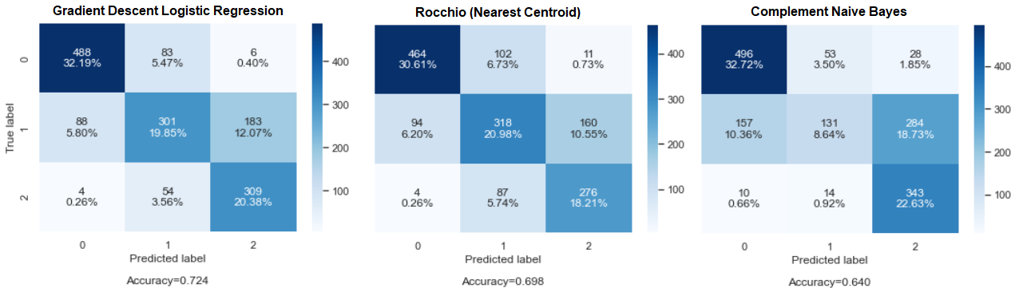
Model Evaluation
3 Best Models (used as ensemble which produced accuracy of 72%)

Slide 10
App Development
App demonstration

